Slide 1

Selenium
All begins from here…
Automation tool to work with browsers

Slide 2
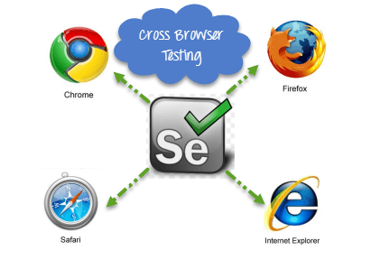

What is Selenium?
Student learning IT
All other students

Slide 3
What is Selenium?
The first Selenium testing tool was developed by Jason Huggins in the year 2004 who was an engineer that time at ThoughtWorks. As a part of his work on testing web applications, Jason has realized that manual testing has become more inefficient due to repetitions of same test cases.
The name Selenium has been adapted from a funny mail sent by Jason to his team. During the development of Selenium, there was a popular testing tool by a company named Mercury Interactive (it was the same company who developed QTP and later it was sold to HP). Since Selenium cures Mercury poisoning, Jason has suggested the same name. The team has adopted it and it is how Selenium got its present name.

Slide 4
4 Components of Selenium
1. Selenium Integrated Development Environment (IDE)
2. Selenium Remote Control (RC)
3. Selenium WebDriver
4. Selenium Grid

Slide 5
Selenium Integrated Development Environment (IDE)
Also know as Selenium recorder
PROS
Very easy to use and install
No programming experience is required. Basic knowledge of HTML and DOM are needed.
Can export tests to formats usable in Selenium RC and WebDriver
Has build-in help and test results repoting module
Provides support for extensions
CONS
Available only in Firefox
Designed only to create prototypes of tests
No support for iteration and conditional operations
Test execution is slow compared to that of Selenium RC and WebDriver

Slide 6
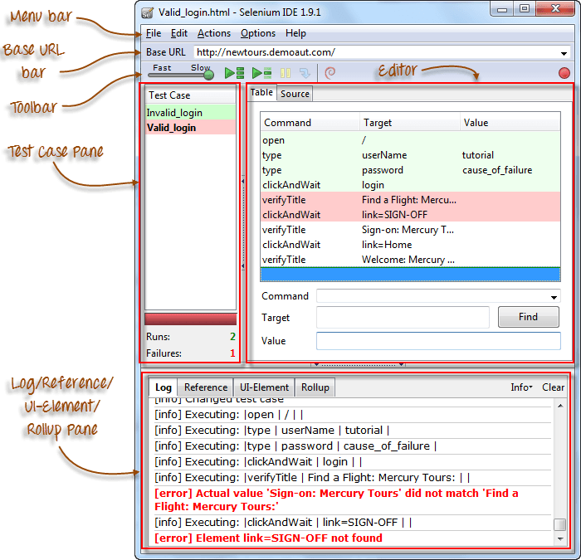
Selenium IDE

Slide 7
Selenium RC
First automation tool that allowed users to use a programming language they prefer.
PROS
Cross-browser and cross platform
Can perform looping and conditional operations
Has matured and complete API
Supports other browsers
Faster execution than IDE
CONS
Installation is more complicated than IDE
Must have programming knowledge
API contains redundant and confusing commands
Inconsistent results
Slower execution time than WebDriver

Slide 8
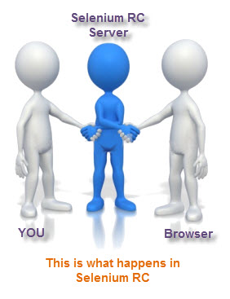
Selenium RC

Slide 9
Selenium WebDriver
You better know it ”IN and OUT”…
PROS
Simpler installation than Selenium RC
Commuticates directly with the browser
Browser interaction is more realistic
No need for a separate component such as the RC Server
Faster execution than IDE and RC
CONS
Installation is more complicated than IDE
Must have programming knowledge
Has no build-in mechanism for logging runtime messages and generating test results
Cannot test images or reCAPTCHAs

Slide 10
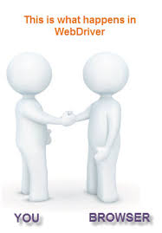
Selenium WebDriver

Slide 11
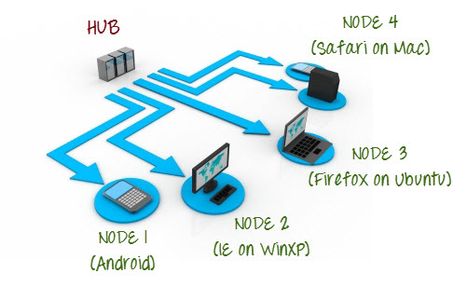

Selenium Grid
Enables simultaneous running of tests in multiple browsers and environments.
Saves time enormously.
Utilizes the hub-and-nodes concept. The hub acts as a central source of Selenium commands to each node connected to it.

Slide 12
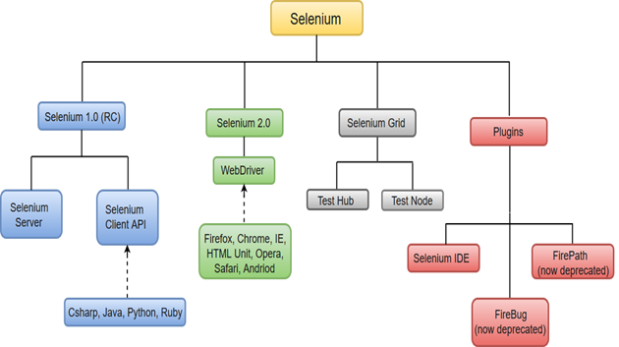
Selenium

Slide 13
Comparison between Selenium and QTP(now UFT)
Selenium
QTP
Open source, free to use, and free of charge.
Highly extensible
Can run tests across different browsers
Supports various operating systems
Supports mobile devices
Can execute tests while the browser is minimized
Can execute tests in parallel.
Limited add-ons
Can only run tests in Firefox, Internet Explorer and Chrome
Can only be used in Windows
QTP Supports Mobile app test automation (iOS & Android) using HP solution called - HP Mobile Center
Needs to have the application under test to be visible on the desktop
Can only execute in parallel but using Quality Center which is again a paid product.

Slide 14
Comparison between Selenium and QTP(now UFT)
QTP
Selenium
Can test both web and desktop applications
Comes with a built-in object repository
Automates faster than Selenium because it is a fully featured IDE.
Data-driven testing is easier to perform because it has built-in global and local data tables.
Can access controls within the browser(such as the Favorites bar, Address bar, Back and Forward buttons, etc.)
Provides professional customer support
Has native capability to export test data into external formats
Parameterization Support is built
Test Reports are generated automatically
Can only test web applications
Has no built-in object repository
Automates at a slower rate because it does not have a native IDE and only third party IDE can be used for development
Data-driven testing is more cumbersome since you have to rely on the programming language's capabilities for setting values for your test data
Cannot access elements outside of the web application under test
No official user support is being offered.
Has no native capability to export runtime data onto external formats
Parameterization can be done via programming but is difficult to implement.
No native support to generate test /bug reports.

Slide 15
Comparison between Selenium and QTP(now UFT)
Cost = because Selenium is completely free
Flexibility = because of a number of programming languages, browsers, and platforms it can support
Parallel testing = something that QTP is capable of but only with use of Quality Center)

Slide 16
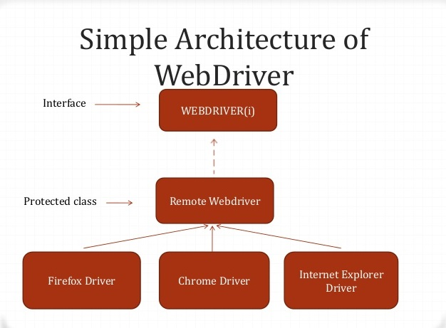
Selenium WebDriver

